Slide 1

Extending Capabilities of the
Military Scenario Definition Language (MSDL)
for Nontraditional Warfare Scenarios
MAJ Erik Whittington, USMC
Curtis Blais, NPS MOVES Institute

Slide 2
Outline
Overview of the Military Scenario Definition Language (MSDL)
New Challenges to Modeling and Simulation
Example Context: Restoration of Essential Services
MSDL Extensions
Conclusions and Recommendations

Slide 3
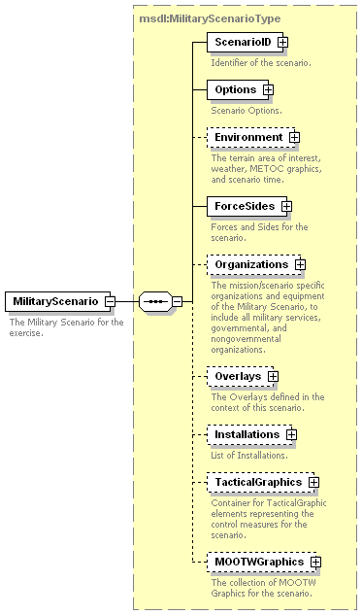
Overview of MSDL
Common structure and content for storage of military scenarios
Version 1.0 approved in SISO in October 2008
Extensible Markup Language (XML) Schemas
Growing number of adopters

Slide 4
New Challenges to M&S
DODD 3000.05, November 2005: Military Support for Stability, Security, Transition, and Reconstruction (SSTR) Operations
“It is DoD policy that Stability operations are a core U.S. military mission that the Department of Defense shall be prepared to conduct and support. They shall be given priority comparable to combat operations and be explicitly addressed and integrated across all DoD activities including doctrine, organizations, training, education, exercises, materiel, leadership, personnel, facilities, and planning.”

Slide 5
Areas of Concern
“Stability operations are conducted to help establish order that advances U.S. interests and values. The immediate goal often is to provide the local populace with security, restore essential services, and meet humanitarian needs. The long-term goal is to help develop indigenous capacity for securing essential services, a viable market economy, rule of law, democratic institutions, and a robust civil society.”
Actions: Military, Intelligence, Diplomacy, Legal, Information, Financial, Economic (MIDLIFE)
Effects: Political, Military, Economic, Social, Information, Infrastructure (PMESII)

Slide 6
E.g., Tasks in Stability Operations
Rebuild indigenous institutions including various types of security forces, correctional facilities, and judicial systems
Revive or build the private sector, including encouraging citizen-driven, bottom-up economic activity and constructing necessary infrastructure
Develop representative governmental institutions
Consider: What needs to be represented in the scenario description to support models & simulations relating to these issues?

Slide 7
Example Context:
Restoration of Essential Services
Investigate extensions to MSDL for scenarios that incorporate PMESII aspects of warfare.
Example context: Modeling civilian population responses to the infrastructure dimension and the resources that the infrastructure provides
Considerations:
  Social Ties (to whom do people turn to obtain needed resources) – authoritative, affective, instrumental
  Resources (what the infrastructure produces)
  Supplies (what units possess)
  Future: production, transportation, distribution of goods

Slide 8
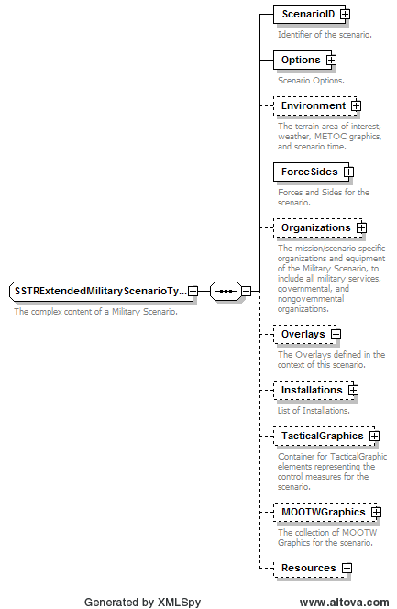
MSDL Extensions
Extended Military Scenario Type
Same structure as original, with addition of Resources element
New extended structures for
  Options
  ForceSides
    Associations
  Organizations
    Units

Slide 9
Data | Name | Description
complexType | SSTRExtendedForceSidesType | Forces and Sides for the scenario.
complexType | SSTRExtendedForceSideType | Force or Side description information.
complexType | SSTRExtendedAssociationsType | Associations between forces and sides.
complexType | SSTRExtendedAssociationType | Association between this force/side and another force/side.
complexType | SSTRExtendedUnitsType | The identification of Units of a Military Scenario.
complexType | SSTRExtendedUnitType | The description of a Unit of a Military Scenario.
complexType | SSTRExtendedOrganizationsType | The mission/scenario specific organizations and equipment of the Military Scenario, to include all military services, governmental, and nongovernmental organizations.
complexType | SSTRExtendedMilitaryScenarioType | The complex content of a Military Scenario.
complexType | SSTRExtendedOptionsType | Scenario Options.
complexType | TiesType | Container for the three types of social ties between entities.
complexType | TieType | Represents a specific connection between two entities.
complexType | ComprehensiveRelationshipType | Contains the standard MSDL Relationship and the Ties container element.

Slide 10
Data | Name | Description
complexType | QuantityType | Data type that will represent a numeric value and the corresponding measurement type.
complexType | SuppliesType | Container for Supply Type.
complexType | SupplyType | Used to represent supplies that a military simulation relevant unit might need. (Bullets, Water, etc.)
complexType | UnitOfMeasurementsType | Represents the data associated with the measurement system. Used in conjunction with Quantity Type elements.
complexType | ResourcesType | Container for Military Resources used in the scenario.
complexType | ResourceType | Defines the framework for basic resources. These resources can be required resources for military equipment or personnel.
simpleType | enumUSVolumeMeasurement | List of common Units of Measurement for supplies and resources.
simpleType | enumMetricVolumeMeasurement | List of common Units of Measurement for supplies and resources.
simpleType | enumMetricMassMeasurement | List of common Units of Measurement for supplies and resources.
simpleType | enumMetricMagnitudeModifier | List of magnitude modifiers such as Kilo and milli.
simpleType | enumUSMassMeasurement | List of common Units of Measurement for supplies and resources.
simpleType | enumLoadType | List of resource and supply load templates
simpleType | VolumeMeasurementType | Union of Enumerations that restrict to acceptable Units of Measure.
simpleType | MassMeasurementType | Union of Enumerations that restrict to acceptable Units of Measure.

Slide 11
Conclusions and Recommendations
Need careful consideration of new directions in M&S for modern warfare and ramifications for the MSDL standard
Encourage other researchers/developers to investigate application of the standard to identify additional capabilities to be evaluated

Slide 12
Questions?
Authors
  MAJ Erik Whittington, USMC
    MAGTF Staff Training Program Center (MSTPC)
    Erik.Whittington@usmc.mil
  Curtis Blais
    Modeling, Virtual Environments, and Simulation (MOVES) Institute
    Naval Postgraduate School
    clblais@nps.edu

